Slide 1



Department of Computer Science and Engineering
Machine Learning-enabled risk prediction of chronic obstructive pulmonary disease
PRESENTED BY GUIDED BY
SRIRAM SS(21CSR208) Mr.N.Aravindhraj,
VIKASH NARAYANAN M(21CSR239) Assistant Professor POOVARASAN V(21CSL267)

Slide 2
ABSTRACT
A study focuses on developing a machine learning-based approach for predicting the risk of chronic obstructive pulmonary disease(COPD) utilizing domain knowledge from the medical field.
COPD is a complex respiratory condition influenced by various factors such as smoking, environmental exposures, and genetic predisposition.
This paper combining feature selection methods, unbalanced data processing methods and machine learning methods with data from disease surveillance questionnaires and physical measurements to identify people at risk of COPD

Slide 3
DOMAIN KNOWLEDGE
Machine learning (ML) is a field of study in artificial intelligence concerned with the development and study of statistical algorithms that can learn from data and generalize to unseen data, and thus perform tasks without explicit instructions.
In healthcare, Machine learning models can analyze patient data, including demographics, medical history, symptoms, and lung function tests, to aid in the early detection and diagnosis of COPD as well as other disorders.
It follows various types such as supervised learning, unsupervised learning, reinforcement learning approaches.

Slide 4
PROBLEM STATEMENT
Chronic obstructive pulmonary disease (COPD) is a common lung disease causing restricted airflow and breathing problems. It is sometimes called emphysema or chronic bronchitis.
Chronic obstructive pulmonary disease (COPD) is the third leading cause of death worldwide, causing 3.23 million deaths in 2019.
Early detection and accurate risk prediction of COPD are crucial for effective management and intervention strategies.
Therefore, there is a pressing need to develop machine learning-enabled approaches that leverage domain knowledge to enhance COPD risk prediction

Slide 5
EXISTING SYSTEM
The existing system for COPD prediction primarily rely on conventional diagnostic methods, based on symptoms, clinical assessments and treatment guidelines.
Spirometry, the gold standard for diagnosing COPD, measures lung function by assessing airflow obstruction and lung volumes. Other diagnostic tests, such as chest X-rays and CT scans, may also be used to evaluate lung damage and rule out alternative diagnoses.
Healthcare professionals conduct comprehensive clinical assessments to evaluate symptoms, disease severity, exacerbation risk, and comorbidities associated with COPD.
But, the main problem in existing systems are delayed diagnosis or under diagnosis,
lacking standardized treatment which results in high mortality rates.

Slide 6
METHODOLOGY / APPROACH
Our approach involves the utilization of machine learning techniques to develop a predictive model for COPD risk assessment.
Data Collection and Preprocessing: Gather a diverse dataset containing demographic, clinical, and lifestyle factors relevant to COPD, including features such as age, smoking history, respiratory symptoms, lung function tests, environmental exposure and preprocess the data to handle missing values.
Feature selection: Identify relevant features that contribute to COPD risk prediction using
techniques such as correlation analysis, feature importance ranking, or domain expertise.
Model training: Utilize supervised learning algorithms such as logistic regression, decision trees, random forests, or support vector machines to train the predictive model using the processed data.

Slide 7
METHODOLOGY / APPROACH
Model evaluation: Assess the performance of the trained model using
metrics such as accuracy, sensitivity, specificity, and area under the
receiver operating characteristic curve (AUC-ROC).
Deployment: Deploy the trained model in a real-world setting to enable
risk prediction for individuals.

Slide 8
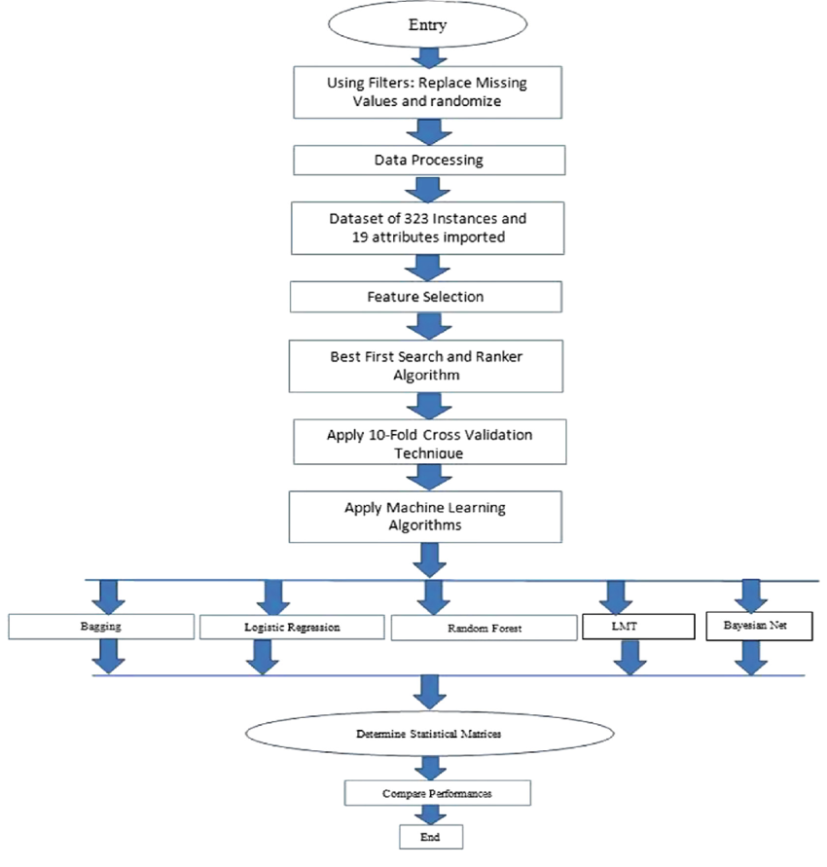
FLOW CHART

Slide 9
REFERENCE
[1] J.L. López-Campos, W. Tan, J.B. Soriano, Global burden of COPD, Respirology 21 (1) (2016) 14–23 (Carlton, Vic).
[2] L. Berlin, Medical errors, malpractice, and defensive medicine: an ill-fated triad, Iagnosis 4 (3) (2017) 133–139 (Berlin, Germany).
[3] C. Wang, J. Xu, L. Yang, Y. Xu, X. Zhang, C. Bai, J. Kang, P. Ran, H. Shen, F. Wen, et al., Prevalence and risk factors of chronic obstructive pulmonary disease in China (the China Pulmonary Health [CPH] study): a national cross-sectional study, Lancet 391 (10131) (2018) 1706–1717 (London, England).

Slide 10
Thank You.!

